Slide 1

Lead through and Textual Programming
Dr Anjan Kumar Dash

Slide 2
Leadthrough programming
The robot is moved through a desired motion path
During this, the controller remembers the path (joint displacements)
Then the robot automatically executes the same path afterwards.
Two types of leadthrough programming
Powered leadthorugh
Manual leadthrough

Slide 3
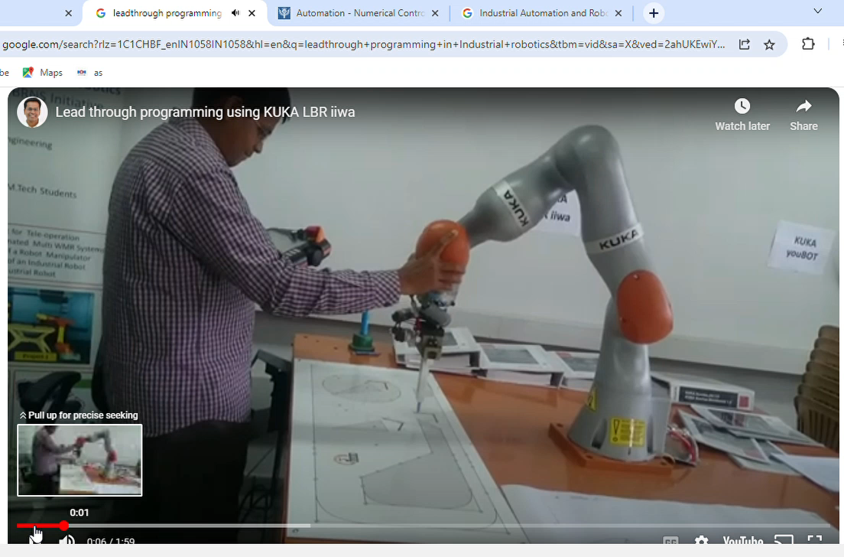

Slide 4
Powered Leadthrough
During this the robot motors are powered. Operator uses a teach pendant to control the motors and take the end-effecter to desired point. As it reaches one point, the operator stores the joint displacement information to controller memory. Then it takes the end-effecter to the next position and stores the corresponding joint displacement information also. Once all the positions are gone through, then the manipulator can go through all the points on its own.
This is most widely used in the industries.
It is used for point to point motion, such as part transfer, machine loading and unloading, spot welding etc

Slide 5
Manual Leadthrough
It is used for continuous and complex tasks
Example: Spray painting, continuous arc welding etc
In this, the robot end-effecter is simply guided through the path by the hand of the operator and while doing that he stores the information of as many points as possible. No teach pendant is used.

Slide 6
Textual Programming
Current practice of robot programming is a combination of Leadthough and textual programming.
Textual programming is used to define the logic and sequence of the program, while leadthrough programming gives the location of the specific points.
This is like off-line-on-line programming. Textual programming is offline and location of the points are determined online through leadthrough programming.
Textual programming is like high level English like language. Some of the textual languages are WAVE, VAL, AL etc.

